Slide 1

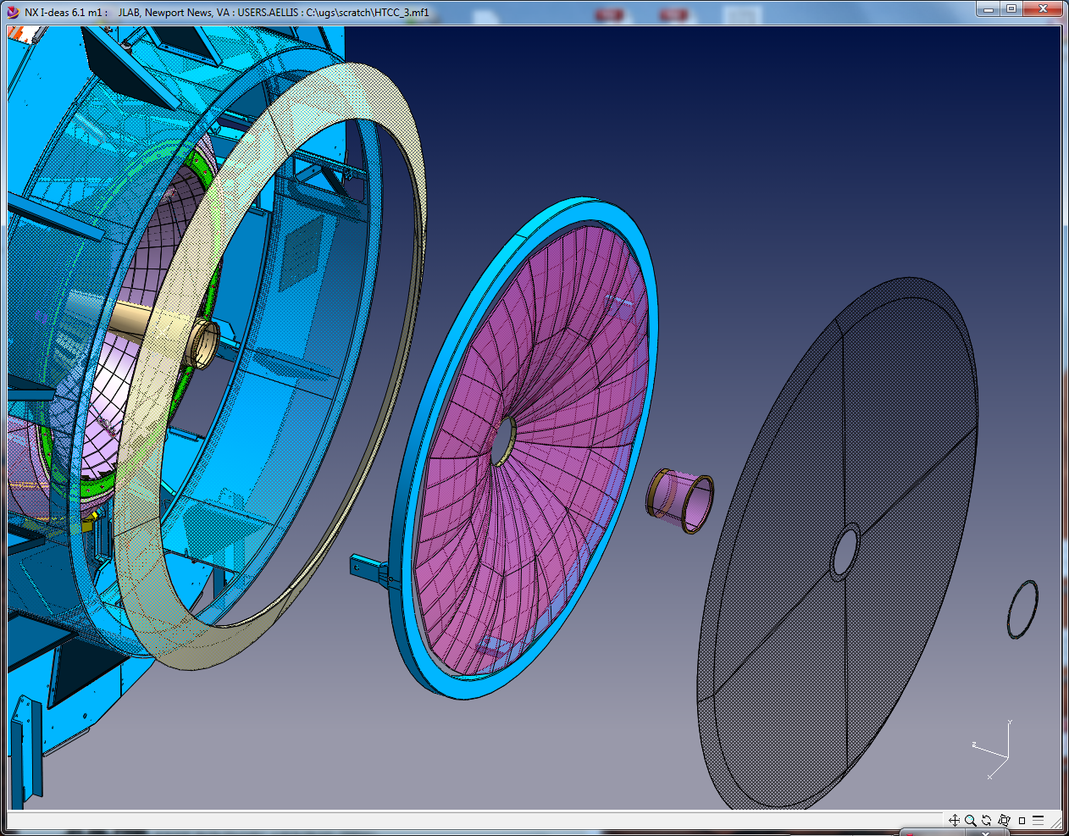

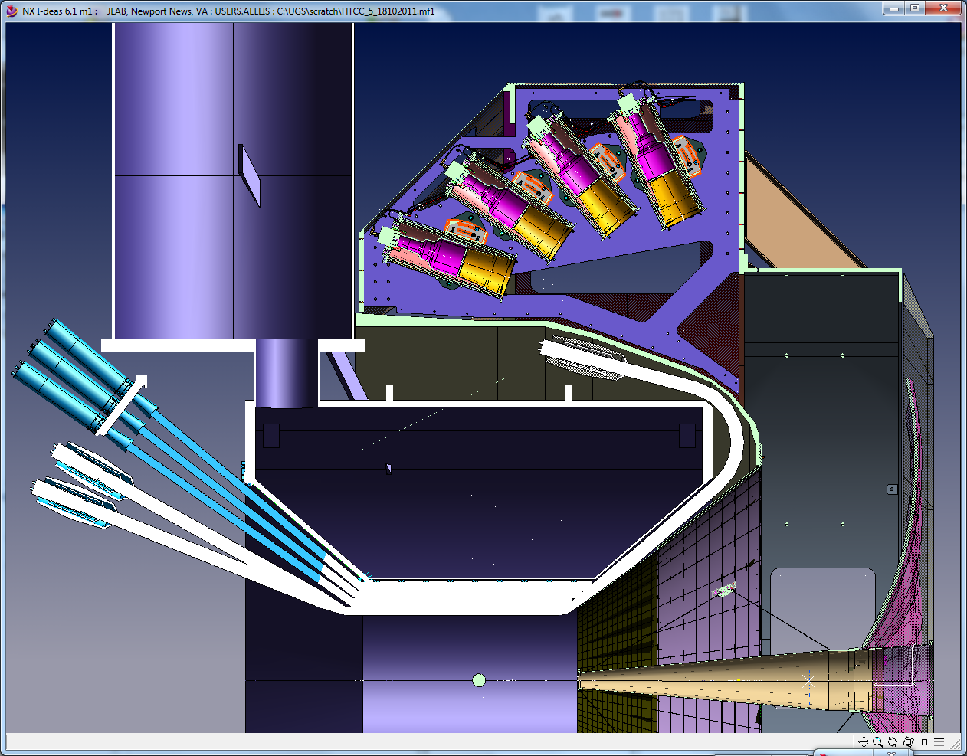
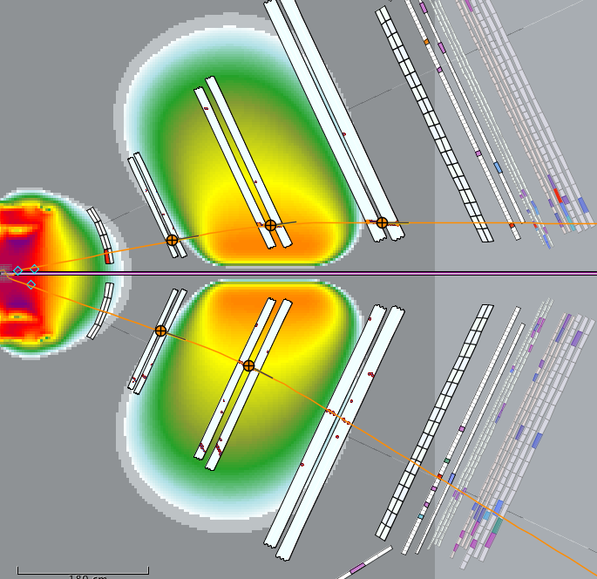
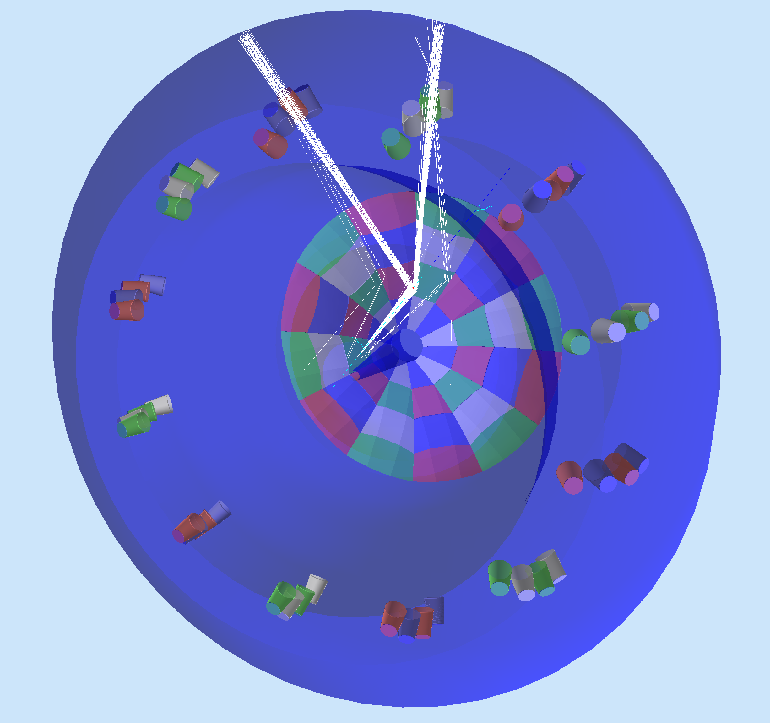
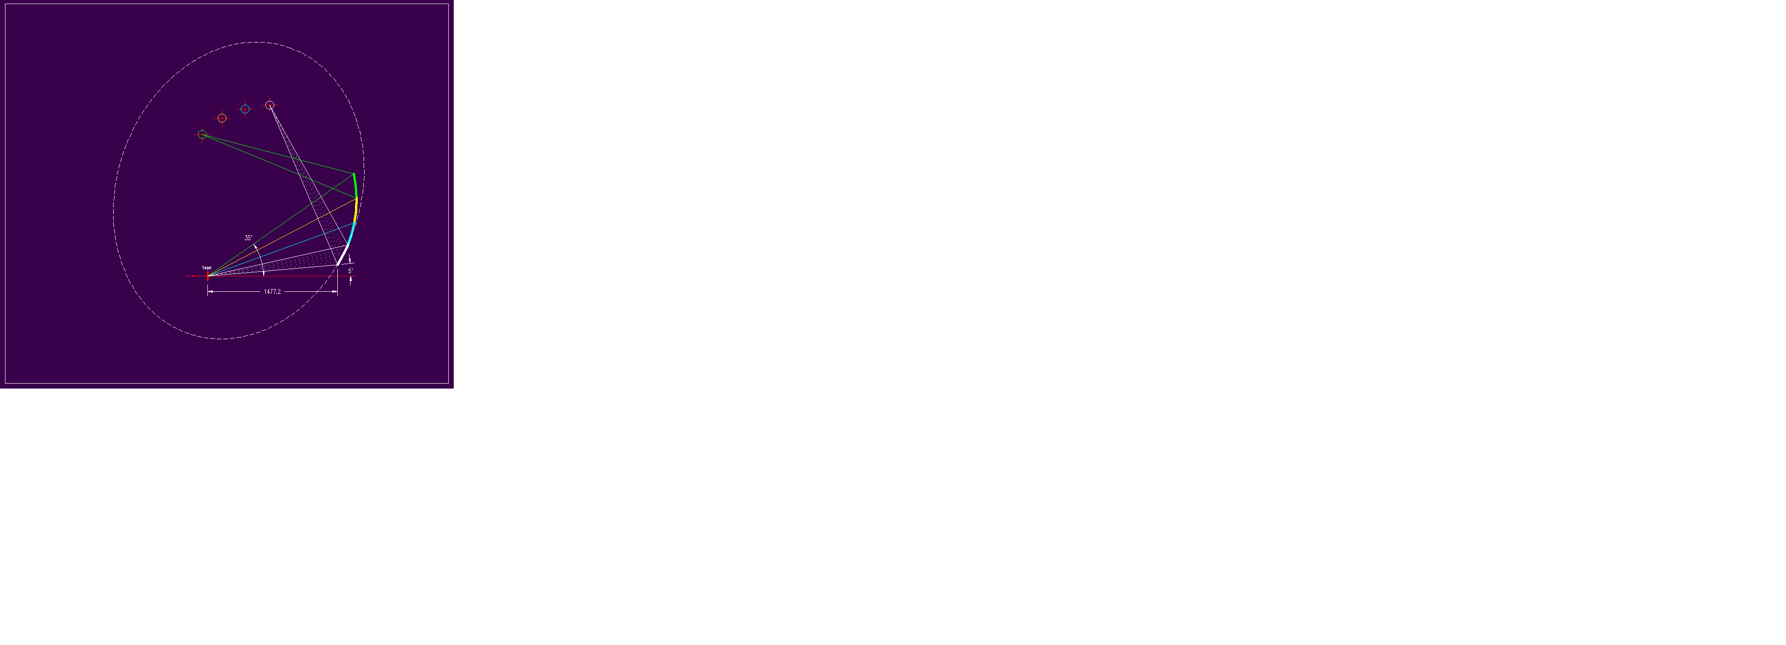
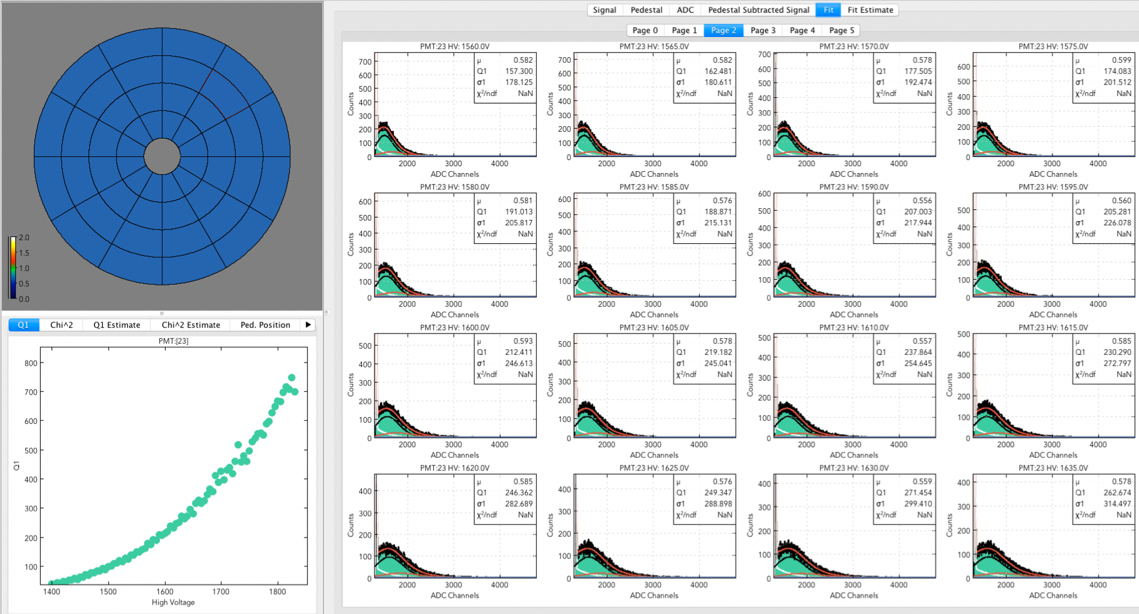
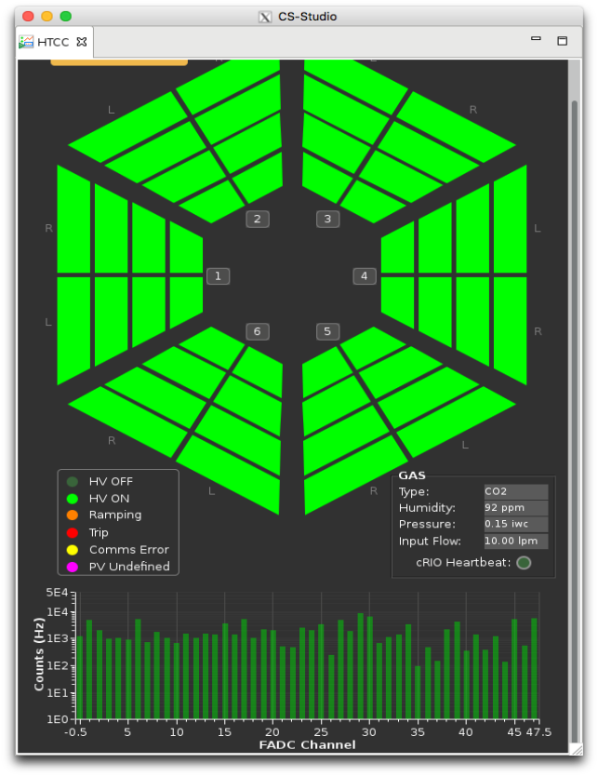
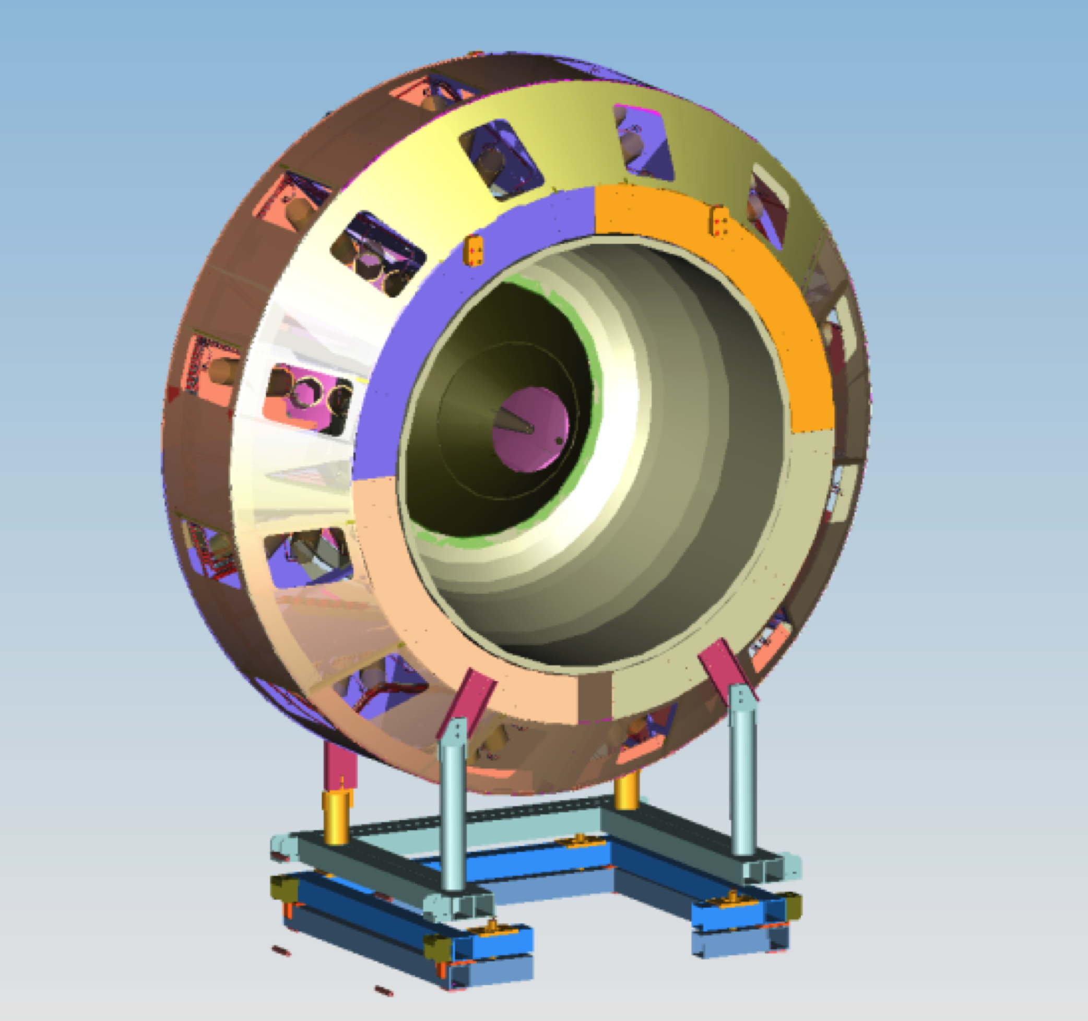
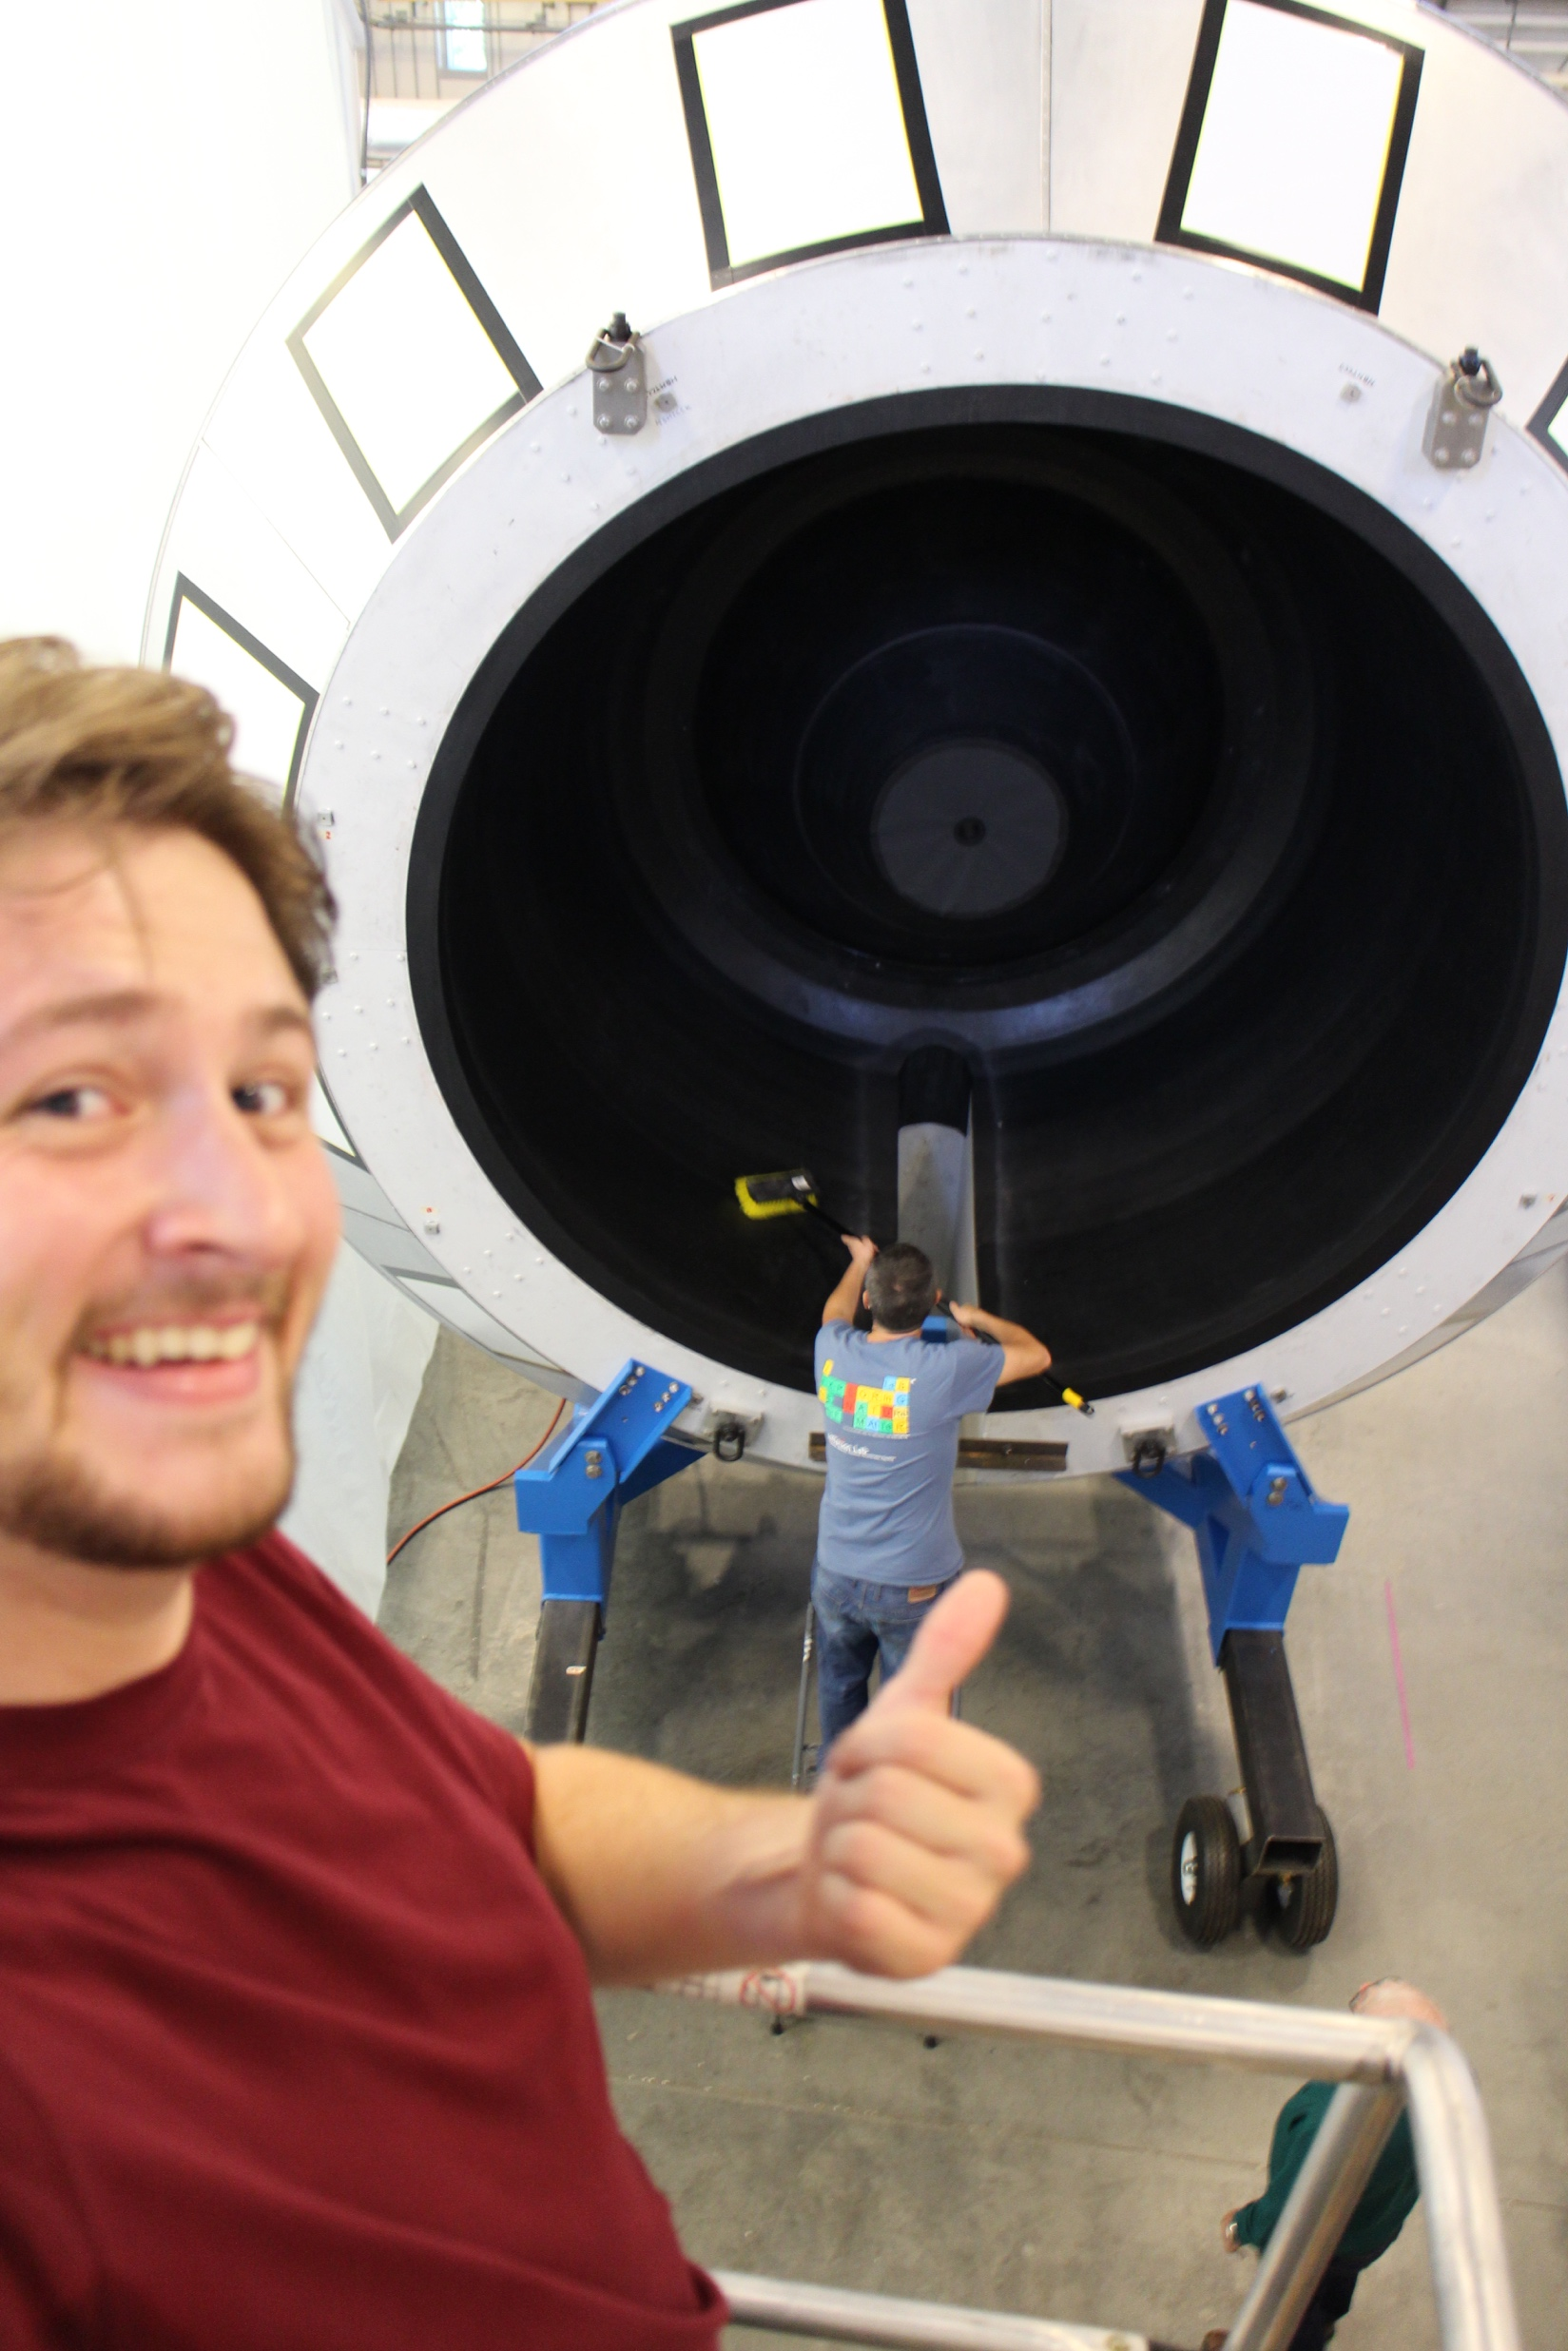
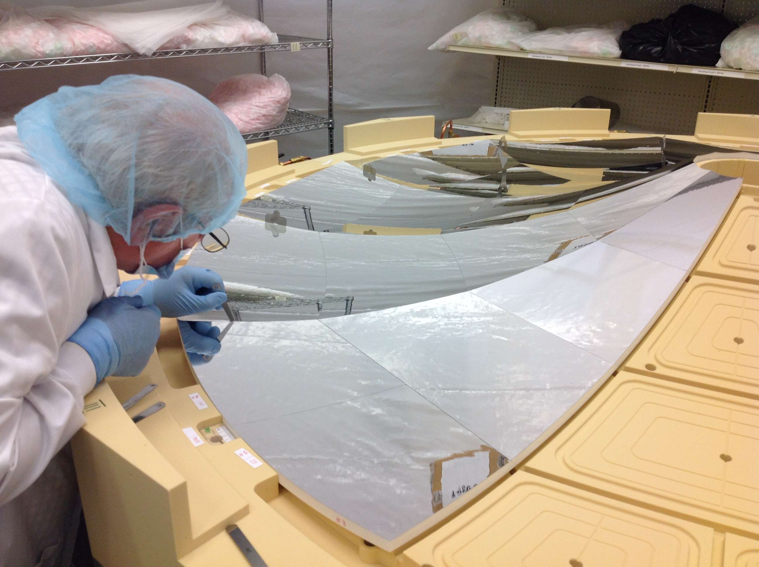
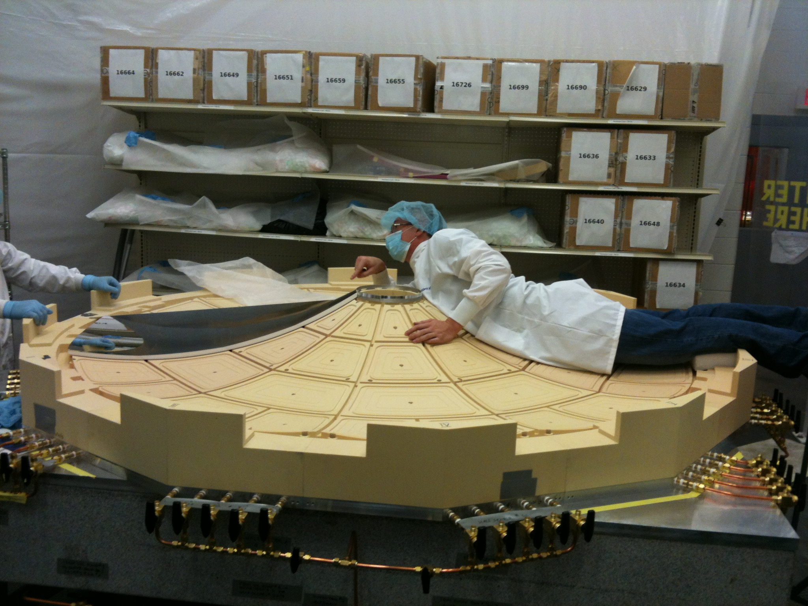
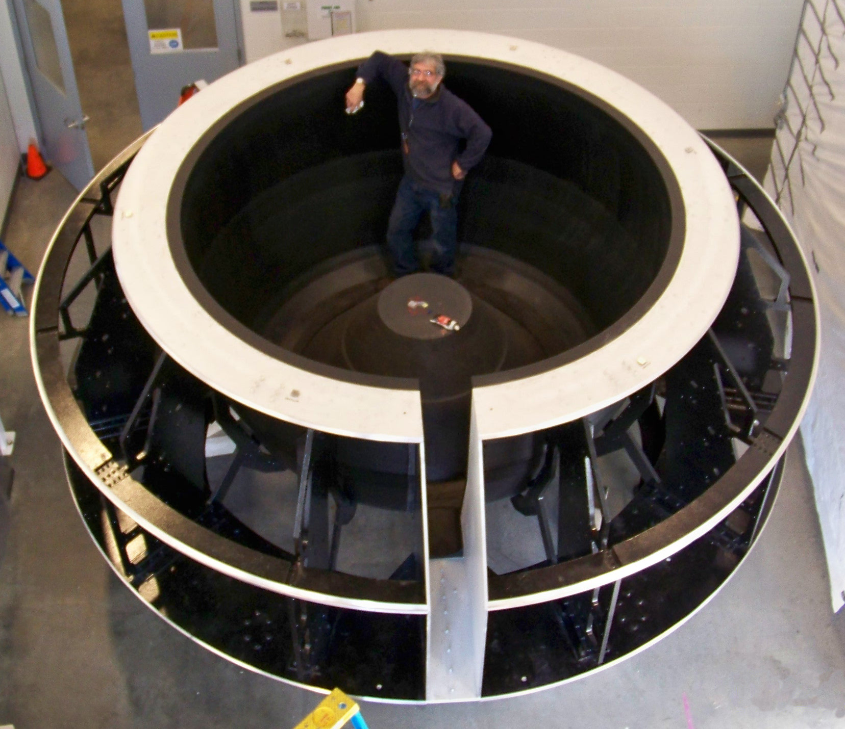
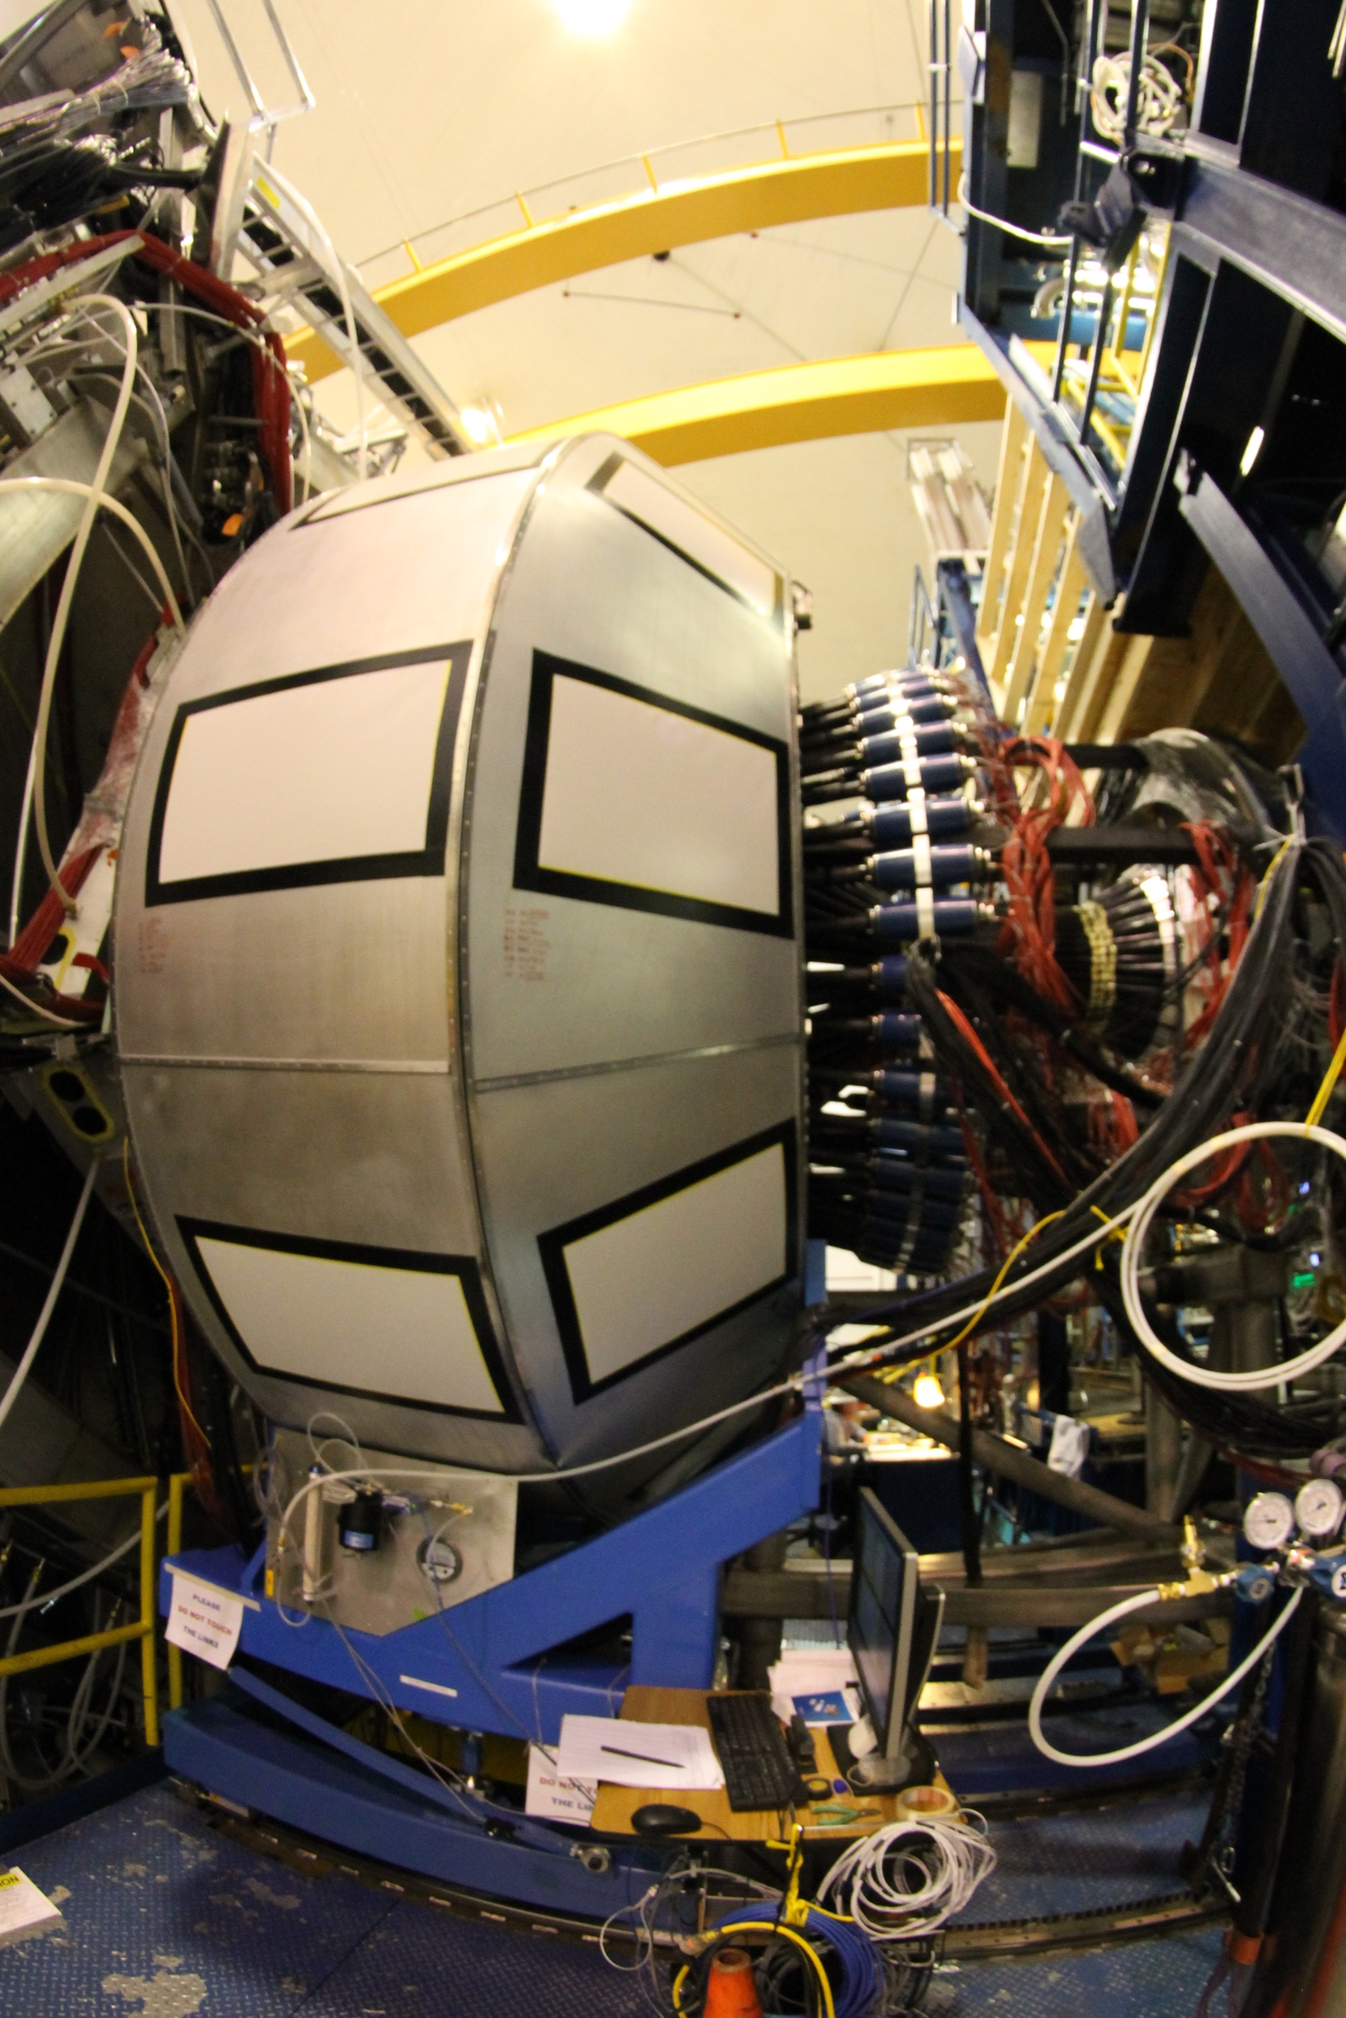
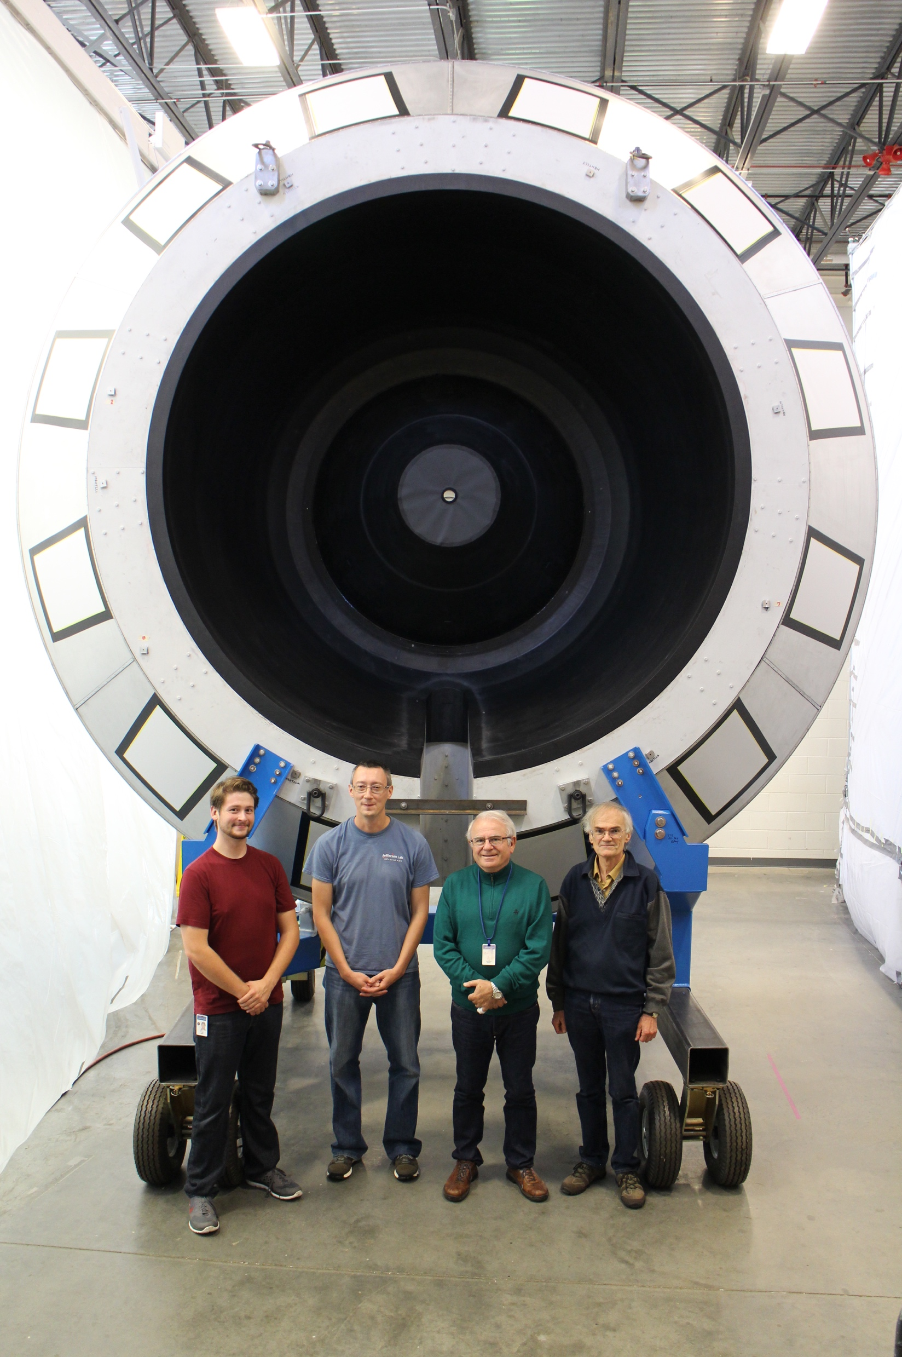
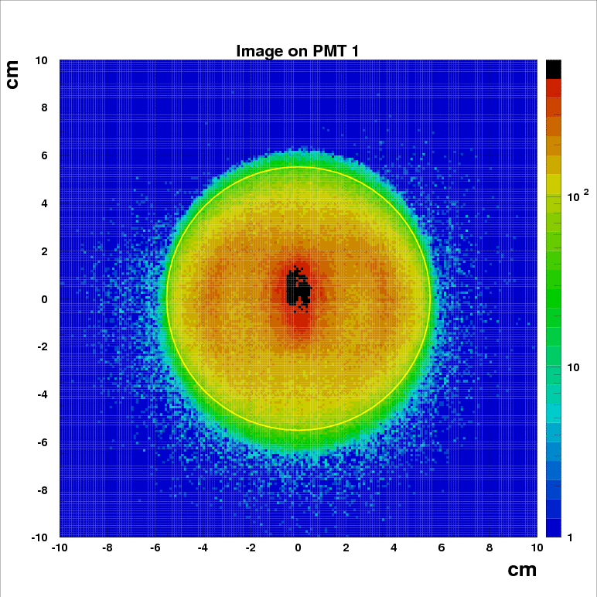
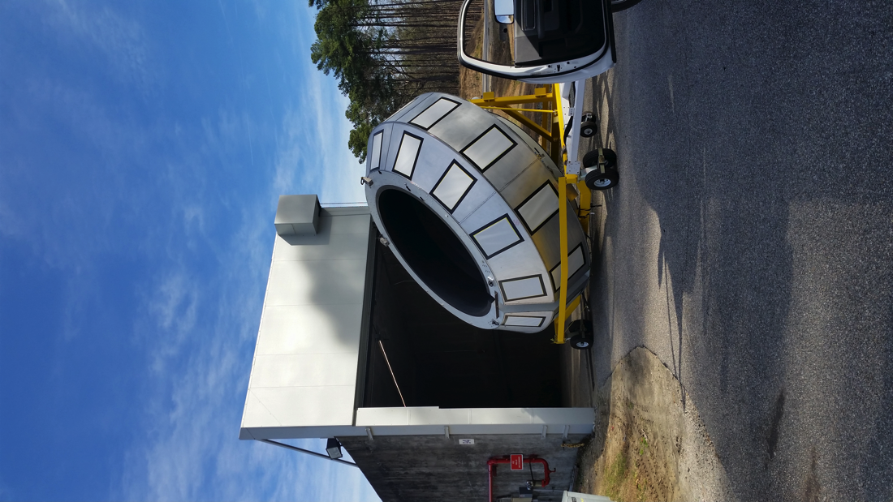
High Threshold
Cherenkov Counter (HTCC)
Thomas Jefferson National Accelerator Facility
What is it?
HTCC In Action
The High Threshold Cherenkov Counter is used to:
Identify electrons
Perform ultra-fast discrimination between electrons and pions /protons
When electrons pass through the HTCC gas (CO₂) they are going faster than light does in CO₂. Consequently, they emit light. This effect (called Cherenkov’s) is similar to the sonic boom of planes when they accelerate to a speed faster than the speed of sound.
We use this effect to distinguish electrons from other particles like pions and protons.
DC Region 2
DC Region 3
DC Region 1
FTOF Panels
This is a representation of a single event taken in April 2018. We collect about 10000 of these events every second.
Left: the focusing of the photons on one photo-sensor. Right: This event has one electron (top) and one positive pion (bottom). You can see that HTCC is working as designed: the electron creates a signal (red hit) and the pion does not. We use HTCC this way to distinguish between electrons and pions in real time: we are able to make these discriminations in one twentieth of a millionth of a second.
Our computer simulation of one electron producing Cerenkov light (the white lines are photons) inside the detector. The world class mirrors focus the light onto two photo-sensors.
3D ellipses math: lines coming from a point (target) are being focused on a single point (photo-sensors). Each HTCC sector has 4 elliptical mirrors focusing the light on 4 different sensors.
Tech Specs
Working Gas: CO₂@1atm, 25ºC
Efficiency: 99.9% electron detection
Number of channels: 48
Mirrors: combined ellipsoidal, dimensions of 8 feet in diameter
Mirror substrate: Acryl (0.01”) + PMI Foam (0.6”) + Acryl (0.01”)
Monitoring suite used to check the hardware status of the HTCC. Top left: all channels are healthy (blue color). Right: all photo-sensor are aligned to give the same response to the same amount of light. This calibration ensures we maximize the precision of our measurements.
High Voltage monitor of HTCC. The photo-sensors run at about 1500 Volts (as a reference, household voltage is 120 Volts). All channels healthy!
Building and Installing SVT
Did you know?
The photo-sensors used in HTCC are so sensitive that they are capable of measuring a single photon. As a reference, in normal light conditions our eyes receive about 200 million photons every second.
Best in class: the mirrors have to made of as little material as possible so particles do not lose energy when crossing them. The HTCC mirrors are a special ellipsoidal design by Youri Sharabian. The whole mirror, some 50 square feet in area, weighs a world record of only 13 lbs.
The ellipsoidal curvature of the HTCC mirrors is shaped with a precision of half a thousandth of an inch.
Electrons typically produce between 20 and 30 photons. Thanks to high reflectivity mirrors almost 90% of these reach the photo-sensors.
Nick Markov sprawling on the building fixture to make sure the first mirrors are set correctly.
Will Phelps taking a selfie while Nick Markov cleans the HTCC entry dish.
Youri Sharabian, who designed many state-of-the-art components for two decades at Jefferson Lab, is the brain behind the HTCC. Here he is making sure the mirrors are glued with a precision of half of one thousandth of an inch. The building and assembly of the detector took place in a “clean room”, a special room where there is absolutely, positively no dust.
Steve “the can-do-all artist” Christo working on HTCC. Steve rocked JLab with his creativity, intelligence and knowledge of materials for more than two decades. He retired in 2017 and he’s now making world class cowboy boots with innovative techniques.
Computer simulation of the photon position hits on the face of the photo-sensor. If all photons came from one single point (the target) they would be focused on the center of the sensor. In reality they are produced along the track of the electron. The simulation results showed the perfect placement of the sensors so they can capture the maximum amount of light.
Contributing Institutions
Will it fit? The HTCC being (oh so carefully!) transported in Hall-B.
PS: yes it fit, JLab engineers and techs made sure of it during the design of the detector and transportation tool. But it was close... The clearance was only half an inch at the doors
Jefferson Lab, Newport News, VA, USA
The HTCC was the last detector to be placed in Hall-B. Here (2017) it is ready to take data.
HTCC complete. From left to right: Will Phelps, Nick Markov, Youri Sharabian and Vladimir Popov.

